Slide 1





360° Optical Flow using Tangent Images
Mingze Yuan and Christian Richardt
University of Bath
EP/S001050/1
EP/M023281/1, EP/T022523/1
Notes:
Hello everyone. Thank you watch the video. My name is Mingze yuan, from university of bath, this work in collaborate with Christian Richardt.

Slide 2
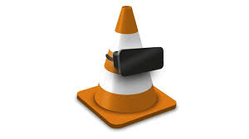
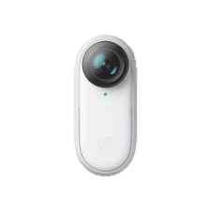
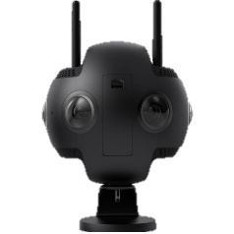
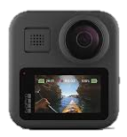
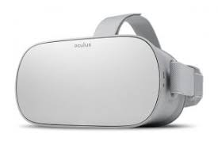
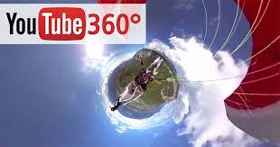
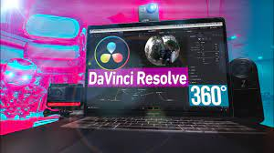
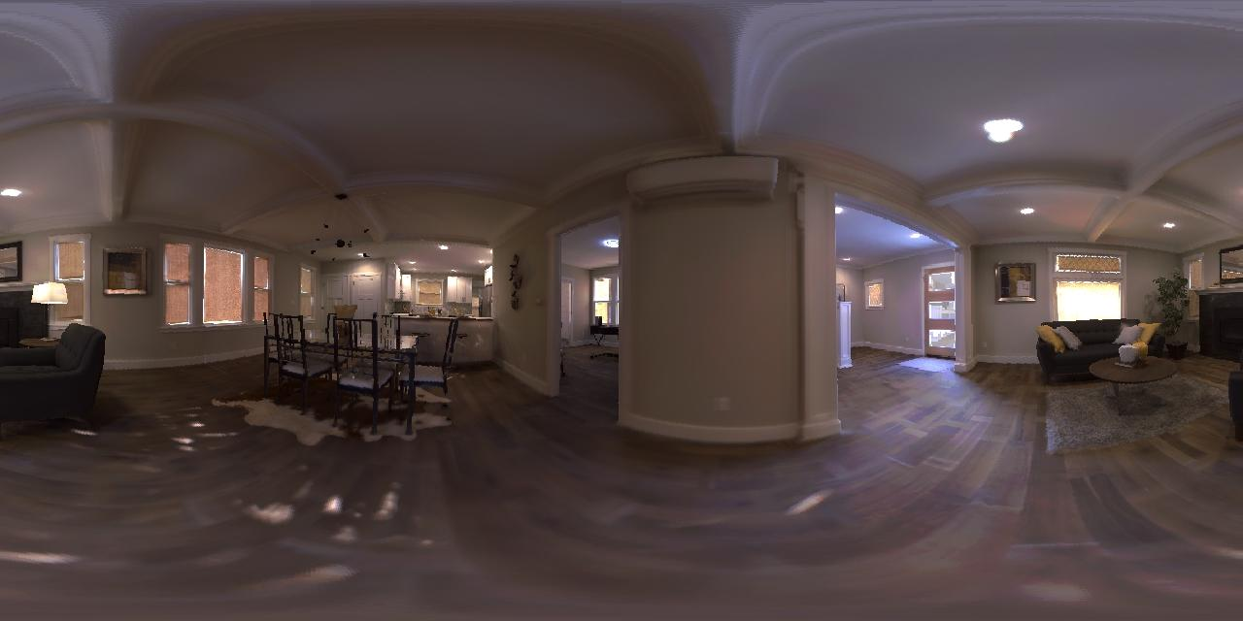
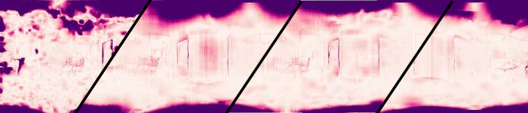

Motivation
360° Cameras
360° Media Distribution
360° Media Display
Need Optical Flow!
DIS
PWCNet
OmniFlow
RAFT
Optical Flow Error Heatmap (darker = larger error)
360° Optical Flow using Tangent Images, MZ Yuan and C Richardt
BMVC 2021
Page 2
Notes:
360° images and videos are becoming increasingly ubiquitous, Optical flow is necessary data for many 360° media processing tasks.
The unique distortion of 360° images is not supported by existing perspective optical flow methods, which show large errors, especially at two poles.
----
as they are supported by evermore 360° cameras, media distribution platforms and displays.

Slide 3
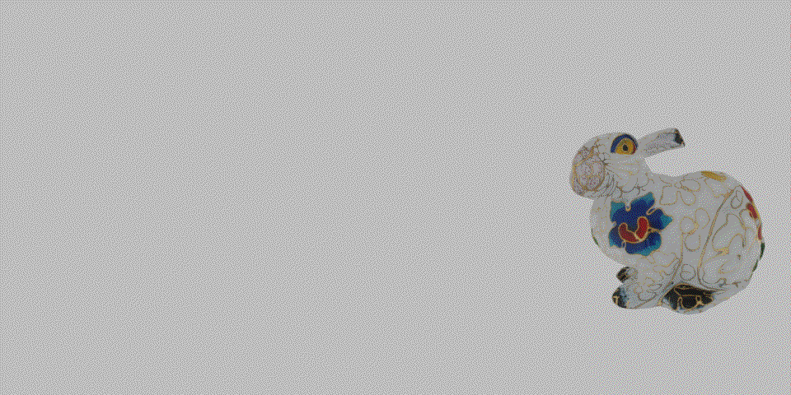
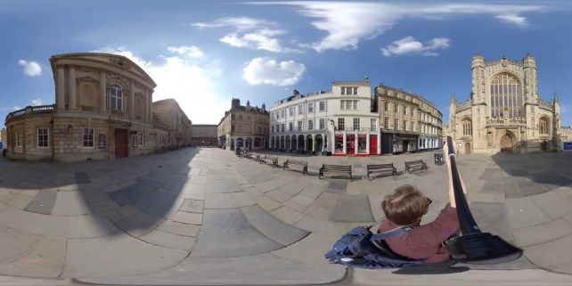
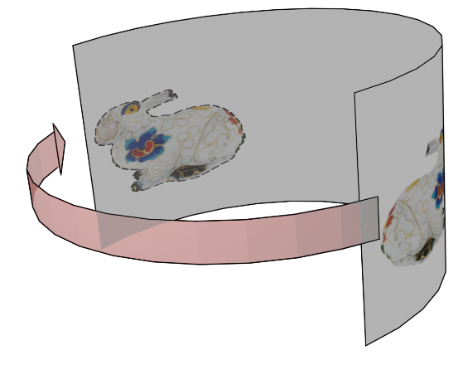
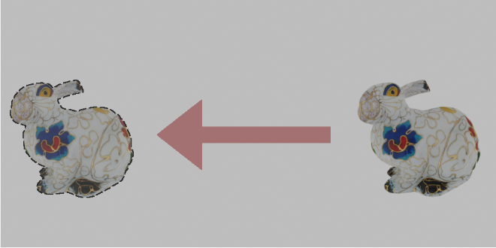
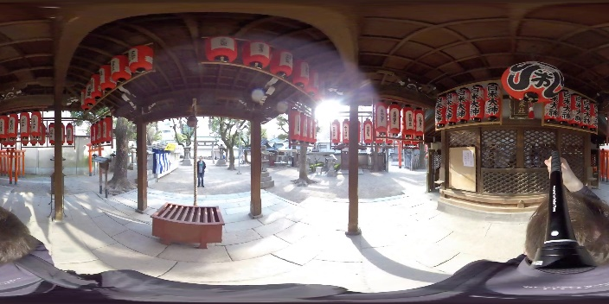
Problems – 360° optical flow definition
Motion
Perspective Image Optical Flow
360 Image Optical Flow
Problem 1: Large Distortion
Problem 2: Wrap-around
360° Optical Flow using Tangent Images, MZ Yuan and C Richardt
BMVC 2021
Page 3
Notes:
Compared to perspective images, the equirectangular projection of 360° images introduces two key problems.
First, large distortions at the top and bottom of the images.
Second, the wrap-around from the left to the right edge of images.
To solve the wrap-around problem, we define 360° optical flow to be the shortest geodesic distance on the sphere.

Slide 4
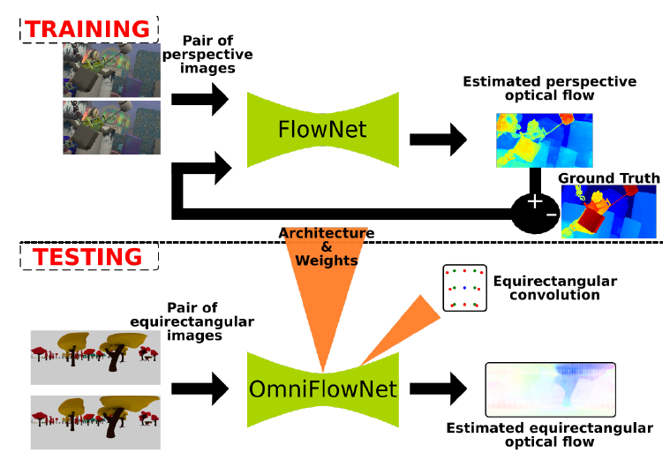
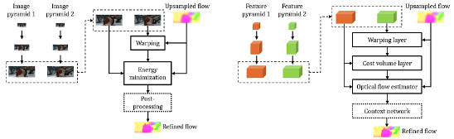
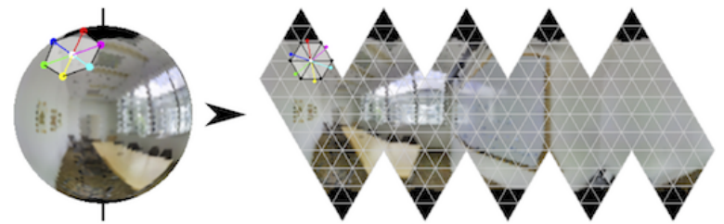
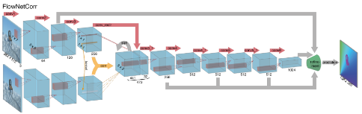
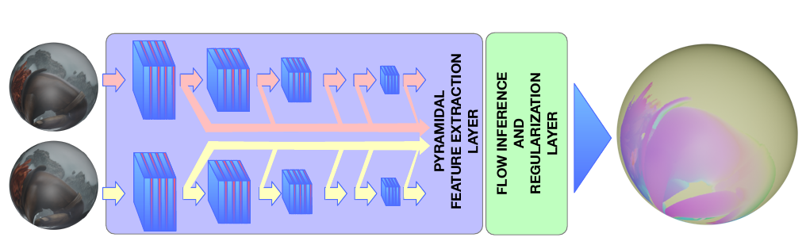
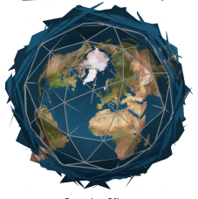
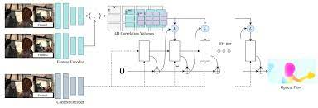
Related Work
PWC-Net
(Sun et al. CVPR 2018)
OmniFlownet
(Artizzu et al. ICPR 2021)
Zhang et al. ICCV 2019
FlowNet
(Ilg et al. CVPR 2017)
360OpticalFlow
(Bhandari et al. ICPR 2021)
RAFT
(Teed et al. ECCV 2020)
Eder et al. CVPR 2020
360 Optical Flow
Perspective Image Optical Flow
Tangent Image
360° Optical Flow using Tangent Images, MZ Yuan and C Richardt
BMVC 2021
Page 4
Notes:
CNN-based 360° optical flow methods are limited by the size of GPU memory, and therefore cannot process high-resolution images.
And perspective optical flow methods are not aware of 360° image distortion.
Inspired by tangent-image-based methods, we propose this method for high-resolution 360° optical flow.

Slide 5
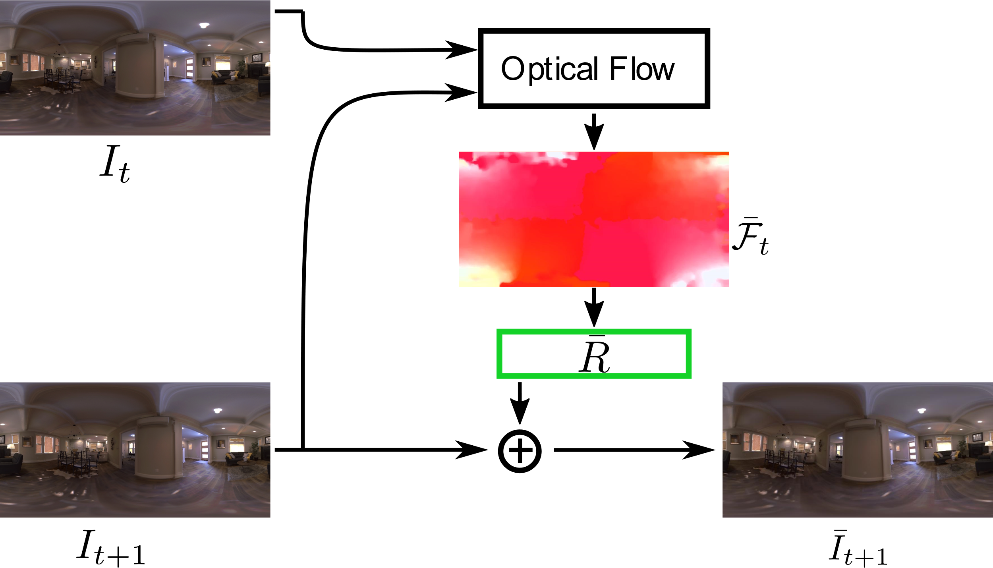
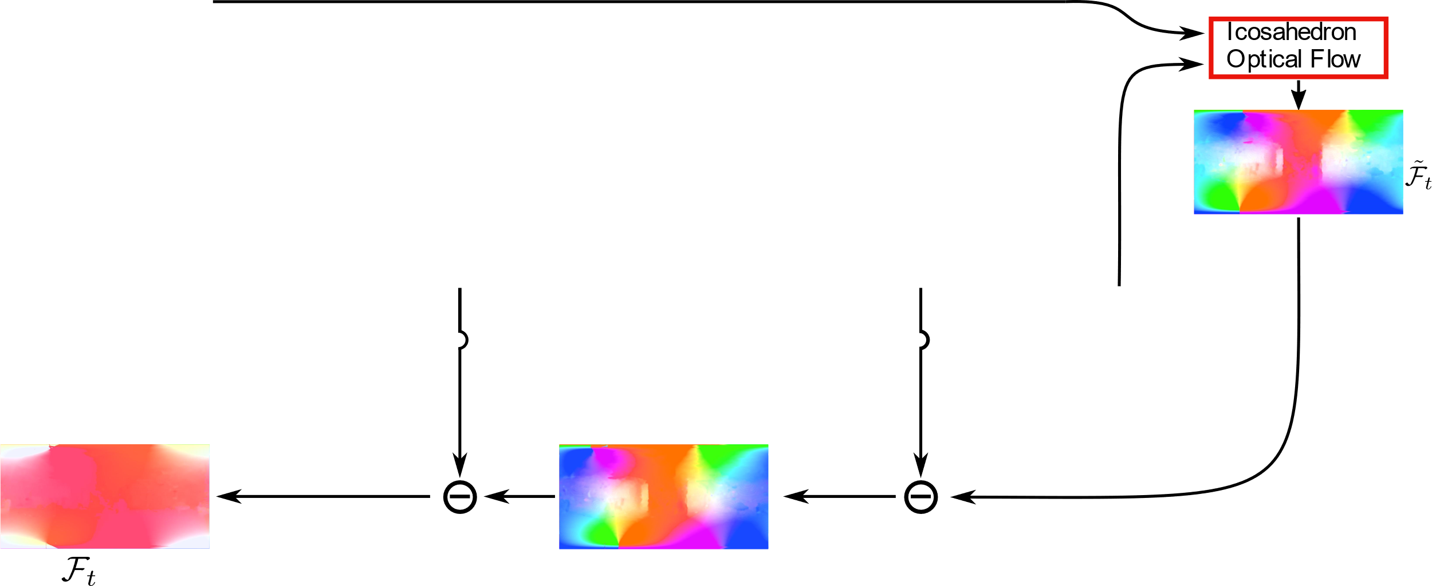
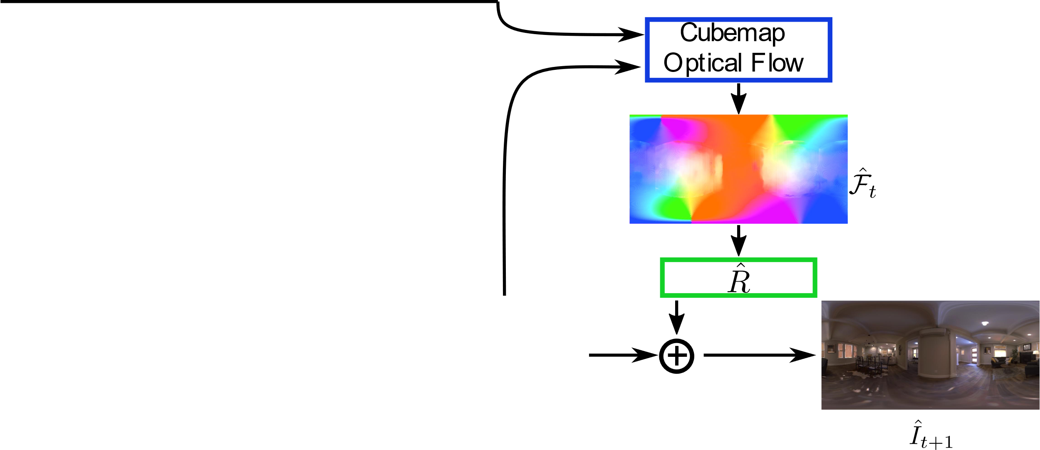
Method – Pipeline
360° Optical Flow using Tangent Images, MZ Yuan and C Richardt
BMVC 2021
Page 5
Notes:
Our method composes of 3 steps.
The first step uses the ERP [equirectangular?] optical flow to align the target image to the source image.
The second step uses cubemap optical flow to reduce 360° image distortions.
The third step uses icosahedron optical flow to refine the local detail, which is fused into the final 360° optical flow with the global rotation warping.
---------------
The key idea is to use gnomonic projection for extracting perspective images from 360° images,
and to use global rotation warping for mitigate the relative motion between two images.

Slide 6
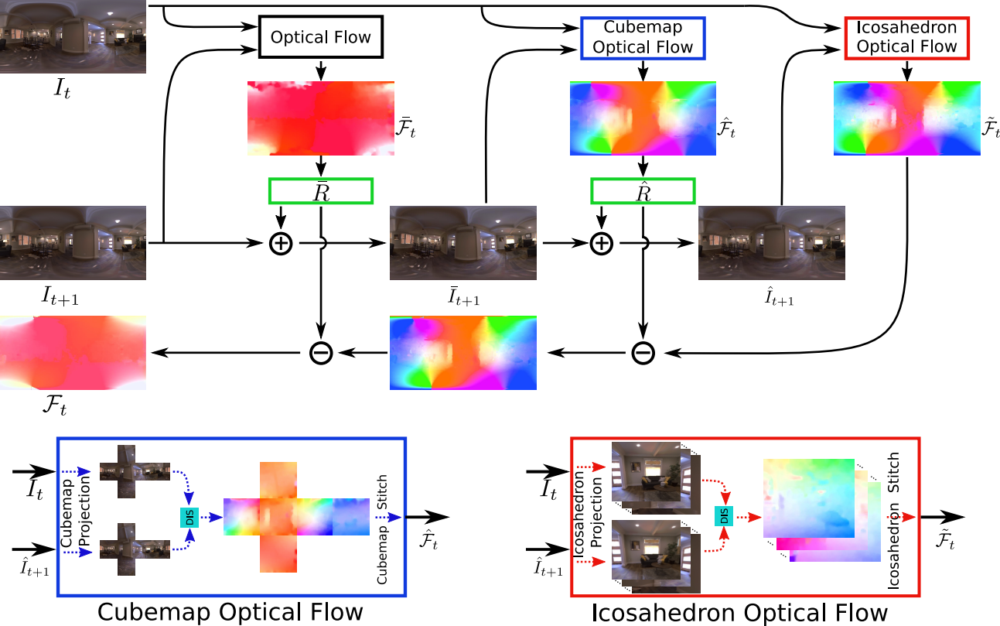
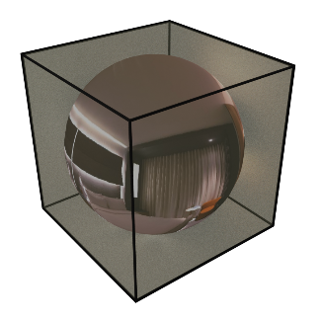
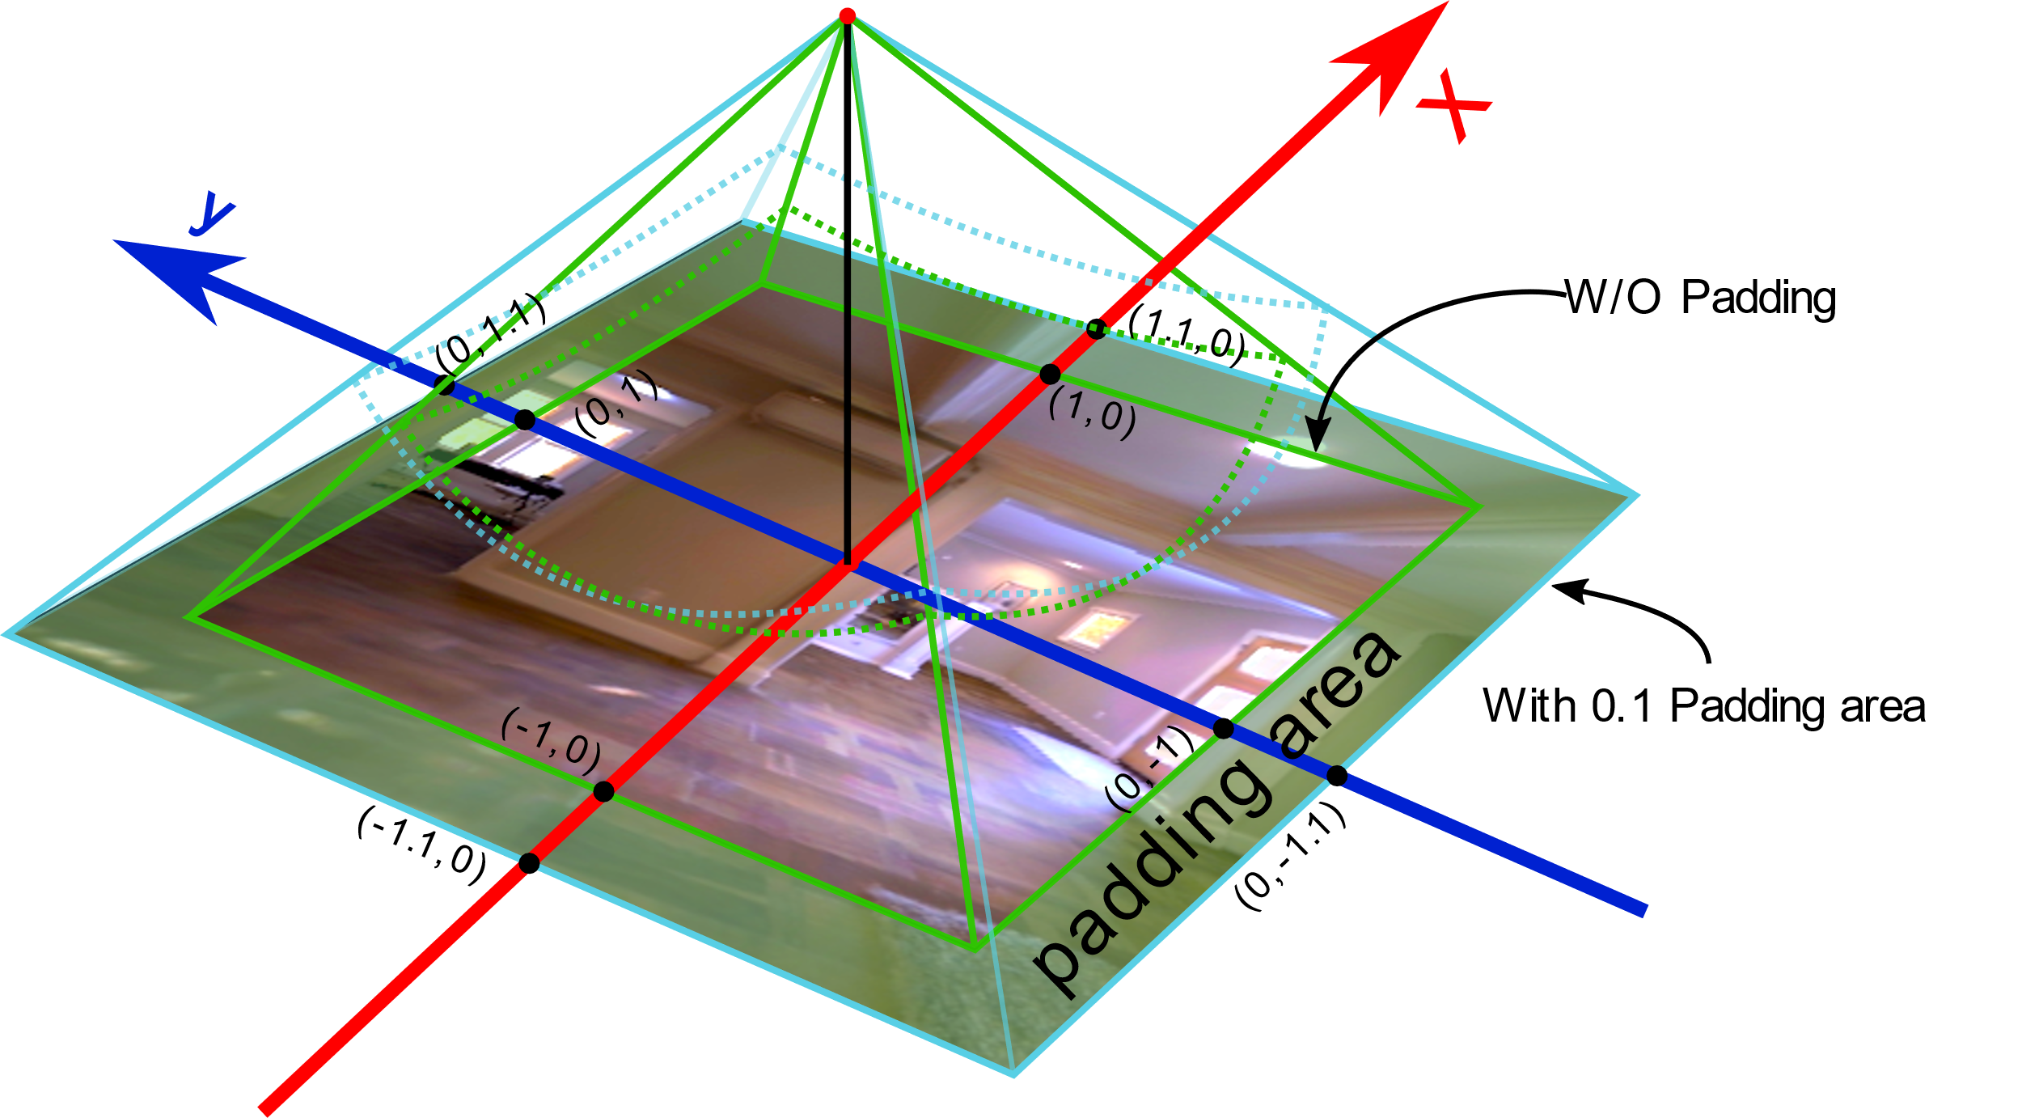
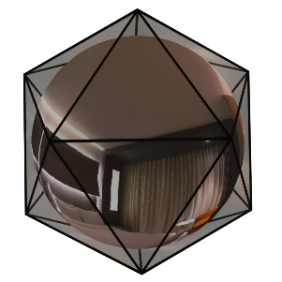
Method – Generate perspective images
360° Optical Flow using Tangent Images, MZ Yuan and C Richardt
BMVC 2021
Page 6
Notes:
To uniformly sample the pixels in the 360° images, we project them to perspective images that are tangent to the faces of first a cubemap and then an icosahedron.
For better optical flow consistency across adjacent tangent images, we pad the tangent images and use the colour difference to blend optical flow in the overlapping regions.
----
We use gnomonic projection to project pixel from a spherical image to the tangent images.

Slide 7
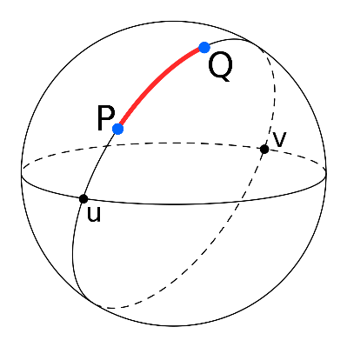


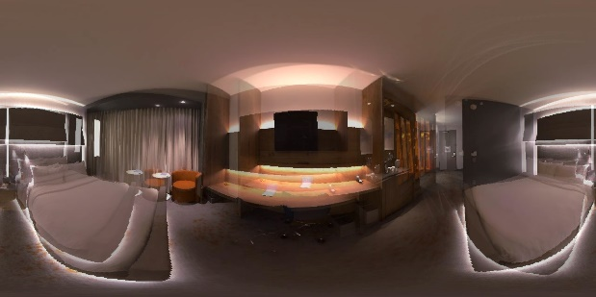
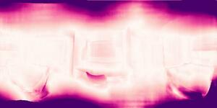

Result
Geodesic distance-based Error Metric:
SEPE, SAAE, SRME
Ours
OmniFlownet
RGB Images
PWCNet
RAFT
SEPE heatmap
360° Optical Flow using Tangent Images, MZ Yuan and C Richardt
BMVC 2021
Page 7
Notes:
We also propose spherical error metrics on the unit sphere using the geodesic distance, which correctly handle distortions and wrap-around.
Our experimental results show that our method can dramatically improve the quality of 360° optical flow, especially at the top and bottom of the images.
Thank you for watching our video.
----
Here, we visualize optical flow errors using the spherical end-point error, or SEPE.
## Propose SEPE, SAAE and SRME.
To measure the quality of 360° optical flow,

